Slide 1

Smart City
Matthew Garcia, Rostyslav Rozhok
EECE 2560 Fundamentals of Engineering Algorithms

Slide 2
Project Scope
Efficiently optimize resource allocation so usage is maximized and waste is minimized.
Account for the dynamics presented within a city.
Completely automate the process of allocating resources.

Slide 3

Key Issues of a City:
Energy management: optimization of use, conversion, transportation, and losses. One of the future practices will be the management of electric vehicles’ batteries to take in the energy when there is surplus of energy and give off when there is shortage.
Trash management. One of the solutions is diligent sorting of trash with further burning to get the energy, and reuse of remnants.
Water purification. Chemicals in detergents, cleaning, fertilizers, pesticides, byproducts of production and heavy metals cause many illnesses. The policies and proper filters are of high priority for a smart city.
Real estate development. New facilities and apartment complexes require infrastructure of energy, water ways, and waste connections and facilities which are usually not present in abundance.

Slide 4

Methodology

Slide 5
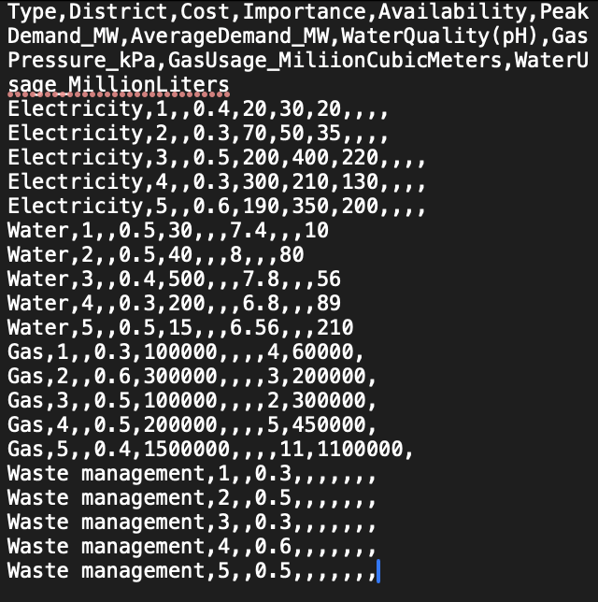
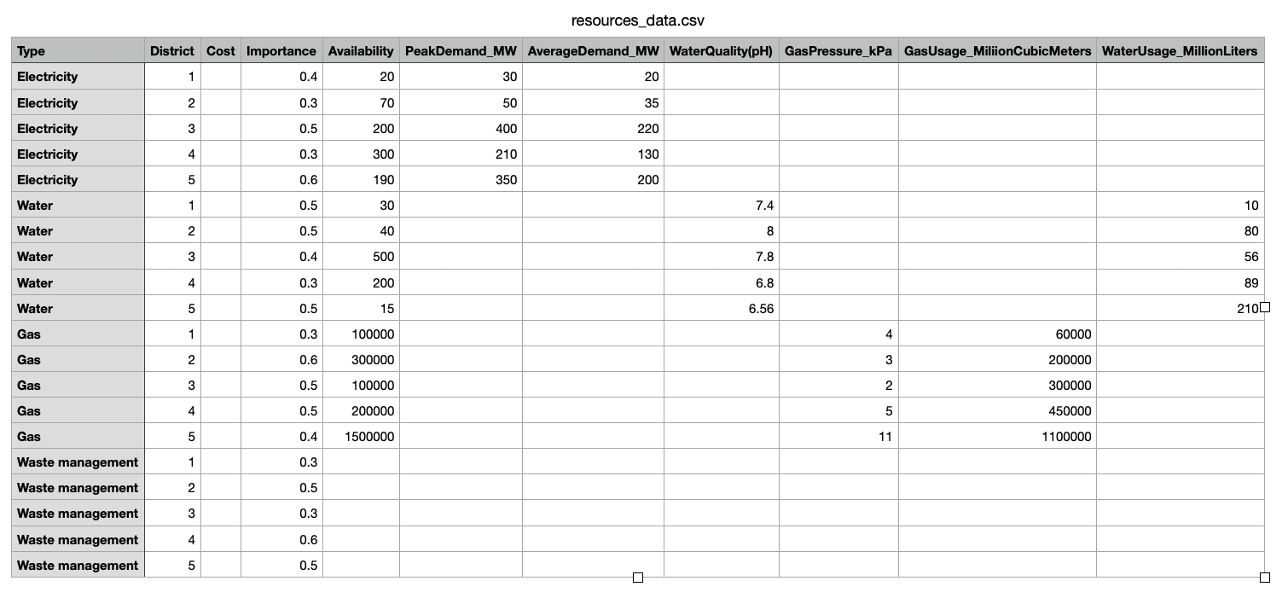
Data

Slide 6
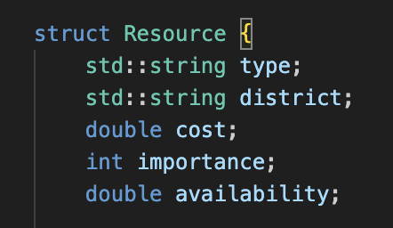
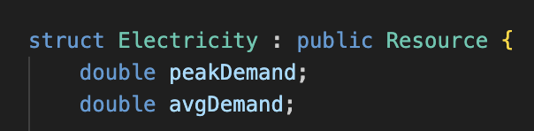
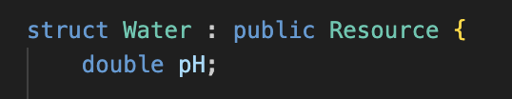
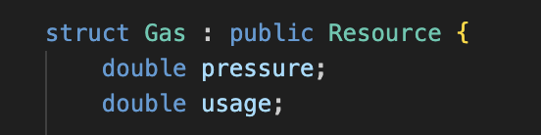
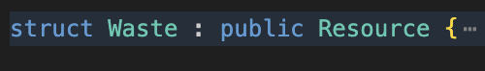
Data Structures
Base Class in ResourceAllocator.h
Derived Classes

Slide 7
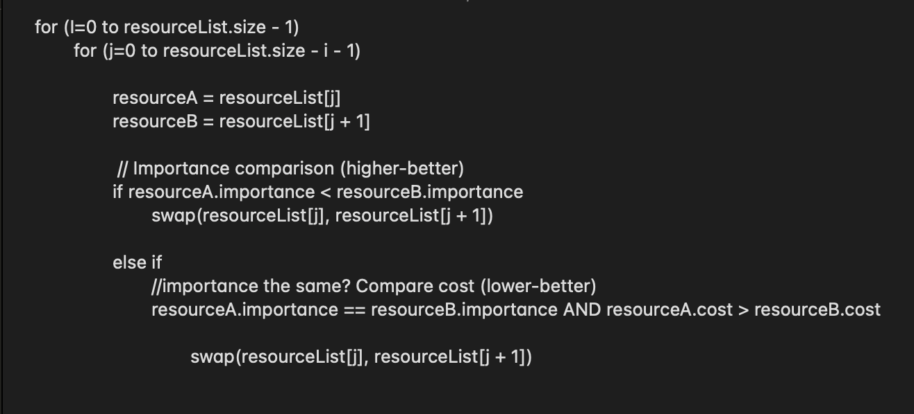
Sorting and Time Complexity
Sorting in ResourceAllocator.cpp
Time Complexity: O(n log n)

Slide 8
Functions
ResourceAllocator() Initialisation of the allocator and call of loadResources to parse input.
void loadResources(const string& file) Parsing of input file and populates resource-specific vectors with data.
void allocateResources() Calling allocation methods for electricity, water, gas, waste.
void allocateElectricity() Sorting of electricity resources and adjusting availability by peak demand.
void allocateWater() and void allocateGas() Reduction of water and gas availability by a fixed amount for each district
void allocateWasteManagement() Deduction of waste management availability with adjustments in the districts.
void displayResourcesbyDistrict()
Displays each district and its respective resources

Slide 9
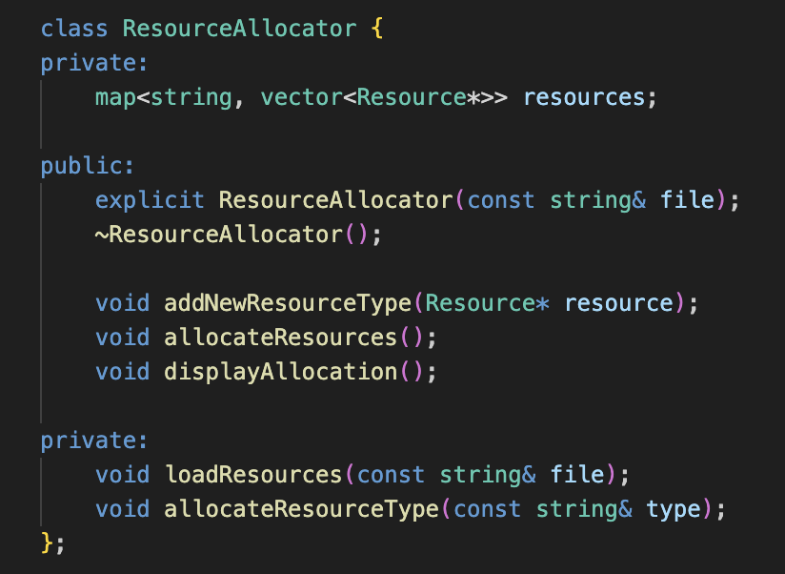
ResourceAllocator class and its methods

Slide 10
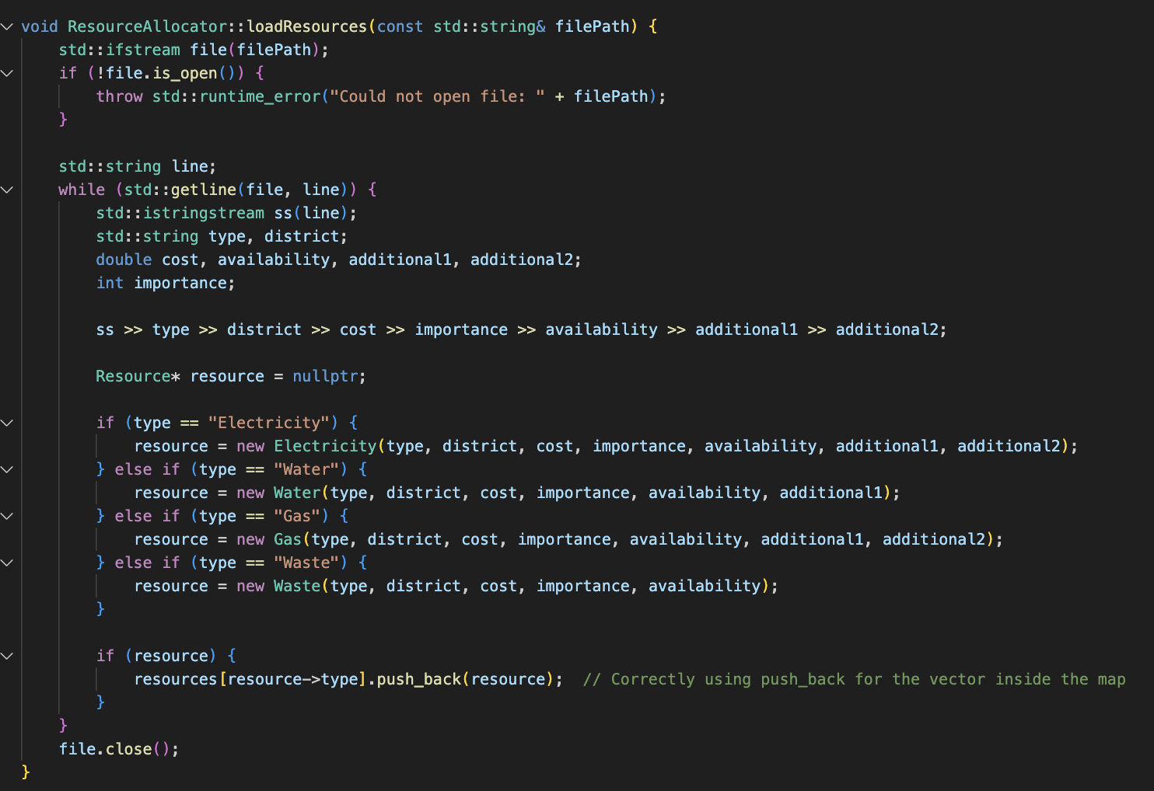
Load Resources
Resource Loading in ResourceAllocator.cpp

Slide 11
Demonstration

Slide 12
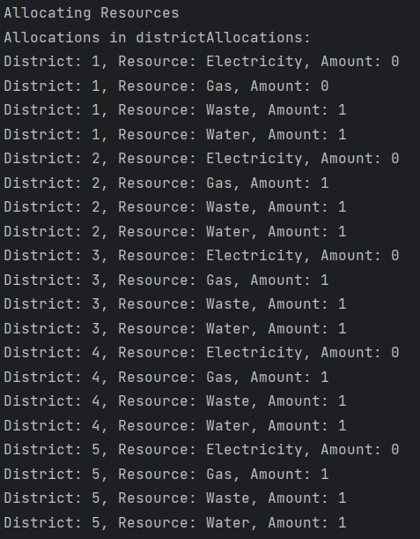
Analysis and Results
Resources were allocated successfully
Users were able to enter in new districts and have resources be reallocated

Slide 13

Discussion
Future valuable additions:
GUI
Graph representation
Expansion of resources’ characteristics
Spent around 3 hours a week on the project

Slide 14

Conclusion
Designing and building Smart Cities is one of the most crucial objectives of humanity in the 21st century. Developments in this area can greatly enhance the living conditions, efficiency and security. Well designed interconnected systems can also allow for much work to be distributed to robots and automated machines.

Slide 15
References
M. Zaman, M. Al Islam, A. Tantawy, C. J. Fung and S. Abdelwahed, "Adaptive Control for Smart Water Distribution Systems," 2021 IEEE International Smart Cities Conference (ISC2), Manchester, United Kingdom, 2021, pp. 1-6, doi: 10.1109/ISC253183.2021.9562812.
R. Chen, R. Wang, W. Zhao, H. Sun, X. Wu and J. Xie, "Cooperative benefit allocation for domestic electricity of smart communities based on coalitional game theory," 2020 International Conference on Intelligent Computing, Automation and Systems (ICICAS), Chongqing, China, 2020, pp. 185-189, doi: 10.1109/ICICAS51530.2020.00045.
Bash, Cullen, et al. “IT for Sustainable Smart Cities: A Framework for Resource Management and a Call for Action.” The Bridge, National Academy of Engineering, 17 Mar. 2023, https://www.nae.edu/290991/IT-for-Sustainable-Smart-Cities-A-Framework-for-Resource-Management-and-a-Call-for-Action.

Slide 16
Thank You

